Slide 1
PROFESSIONAL GUEST MANAGEMENT SYSTEM AND AUTOMATED LINUX SCRIPT(VULSOLN)
Presented By:
Kashish 12111693
Monika Rastogi 12101666
Anchal Sagar 12100174

Slide 2
Introduction
A Professional Guest Management system is a website designed to rent out rooms or beds to paying guests
The objective of this project is to create a user-friendly platform for finding and renting PG accommodations.
Purpose of the Website is to create a streamlined platform for users to easily search, view, and book PG accommodations.
In the current era of technology and cybersecurity, it is critical to identify vulnerabilities and security flaws in computer systems before attackers can exploit them. Penetration testing and vulnerability assessments are essential tools for identifying and resolving vulnerabilities in computer systems.
Automated testing scripts are an effective way to streamline these processes. This report provides an overview of automated testing scripts for vulnerability assessment and penetration testing in cybersecurity.

Slide 3
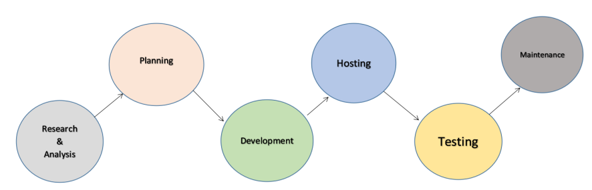
Life Cycle

Slide 4
System Design
User Interface (UI) Design: The UI design focuses on creating an intuitive and visually appealing interface for users. It involves designing elements such as layouts, typography, colors, buttons, forms, navigation menus, and other interactive components.
Front-End Development: Front-end development is the implementation of the UI design using web technologies like HTML, and CSS. It includes writing code to structure web pages, style them, and add interactivity. Consider responsiveness to ensure the website is accessible and displays properly across different devices and screen sizes.
Back-End Development: Back-end development deals with a website's server-side logic and functionality. It involves creating a server, managing databases, handling user authentication and authorization, implementing business logic, and integrating with external services or APIs. Popular back-end technologies Python.
Database Design: If your website requires storing and retrieving data, you'll need to design a database schema. This involves defining the structure of the database, organizing tables, establishing relationships between entities, and optimizing the database for efficient data retrieval and storage.
Security: Security is crucial for protecting user data and maintaining the integrity of your website. Implement measures such as secure authentication, encryption, input validation, protection against common web vulnerabilities (e.g., cross-site scripting, SQL injection), and regular security audits.

Slide 5
Technologies Used
For Development:
HTML
CSS
PHP
MY SQL
For Hosting:
Hostinger
For Testing:
Created an automated testing script named Vulsoln(Bash)

Slide 6
Development
The front-end implementation of the website used HTML and CSS to create the user interface.
The server-side processing layer was implemented using PHP, which allowed for dynamic content generation and database connectivity.
The back-end database was designed using MySQL, which stored user and listing information.
Integration of HTML, CSS, and PHP, along with proper database design, ensures a functional PG Rental System that provides a user-friendly interface, seamless functionality, and efficient data management for finding and renting PG accommodations.

Slide 7
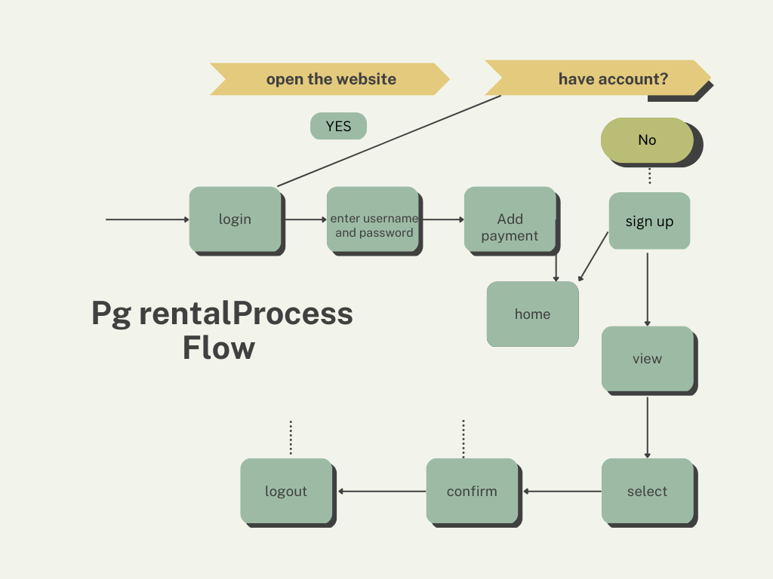

Slide 8
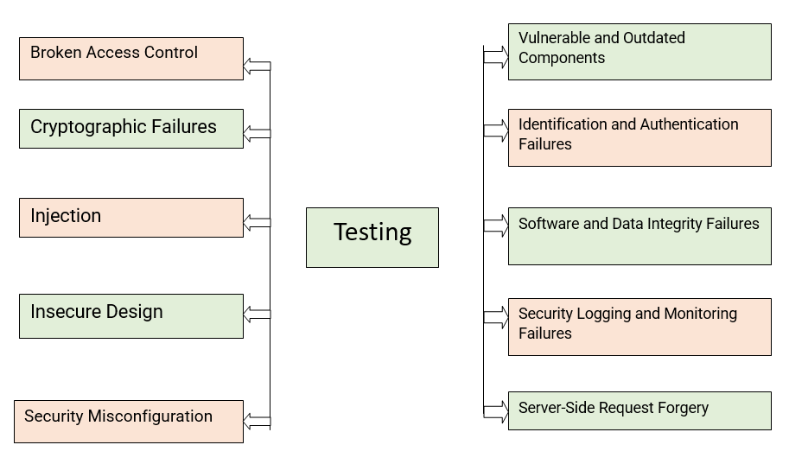
Testing

Slide 9
Implementation of Website
Planning: This involves defining the goals and requirements of the PG rental system and creating a plan for its development. The review paper may evaluate how well the planning process was executed, and if the goals and requirements were met.
Design: This involves creating a design for the user interface and the database schema. The review paper may assess the design choices made, such as the use of responsive design to ensure compatibility with various devices, and the normalization of the database schema to ensure data integrity.
Coding: This involves writing the HTML, CSS, and PHP code for the system. The review paper may evaluate the quality of the code, such as the use of commenting to enhance code readability, and the use of security measures to prevent hacking.
Testing: This involves testing the system for functionality, performance, and security. The review paper may evaluate the effectiveness of the testing process and the methods used to identify and fix bugs and security vulnerabilities.
Deployment: This involves deploying the system to a production environment. The review paper may evaluate the deployment process, such as the use of version control to ensure consistency across different environments, and the use of backups to protect against data loss.

Slide 10
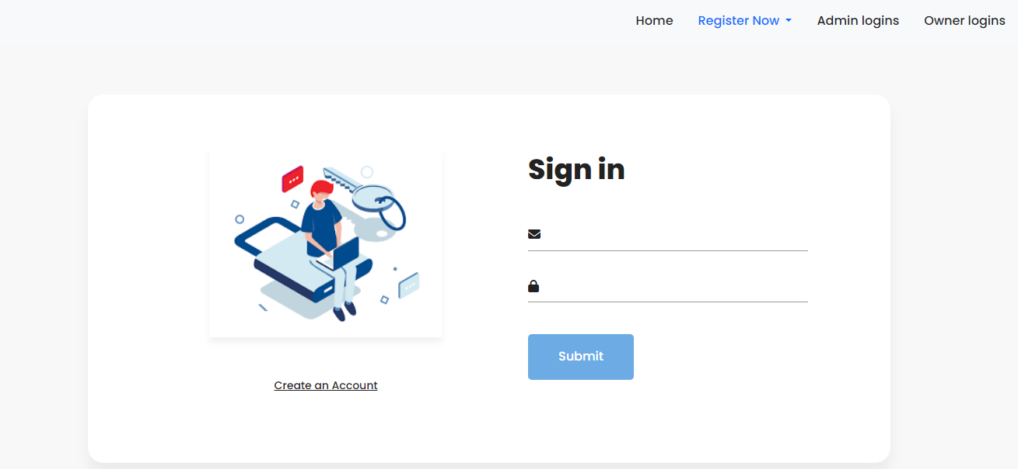

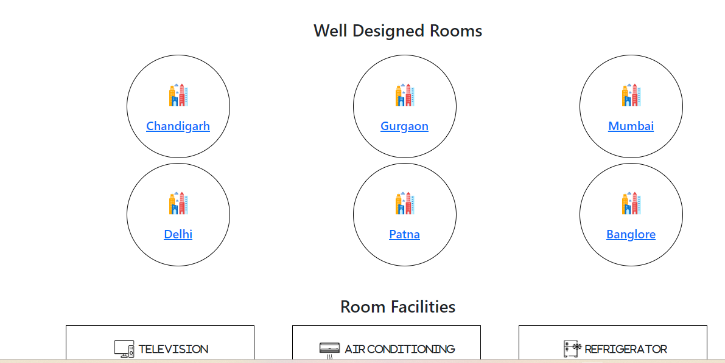
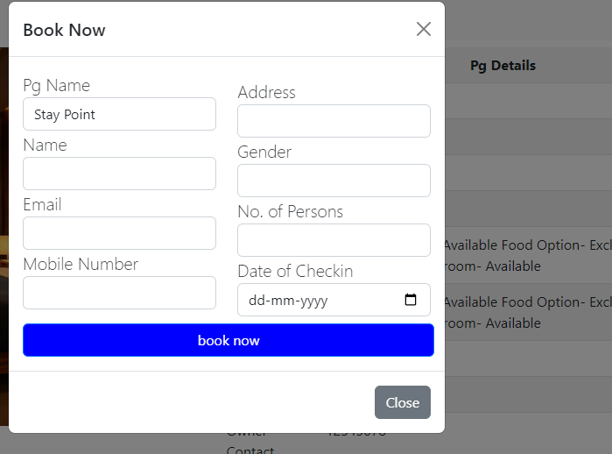

Slide 11
Hosting of website
Online Presence: Hosting a website allows you to establish an online presence and make your website available to users worldwide
Website Accessibility: By hosting a website, you ensure that it is accessible to anyone with an internet connection. Users can access your website by typing in your domain name or clicking on a link, and the hosting server delivers the web pages and content to their browsers.
File Storage and Management: Web hosting provides server space where you can store your website files, such as HTML, CSS, JavaScript, images, videos, and other resources. Hosting servers are designed to handle large amounts of data and deliver it to users quickly and efficiently.
Data Security: Hosting services often provide security measures to protect your website and data. These may include firewall protection, DDoS (Distributed Denial of Service) mitigation, malware scanning, and regular security updates.
Domain Name Mapping: When you host a website, you can associate it with a unique domain name, such as "www. professionalguestmanagementsystem.com". Hosting services allow you to link your domain name to the hosting server's IP address, enabling users to access your website using the memorable and branded domain name.

Slide 12
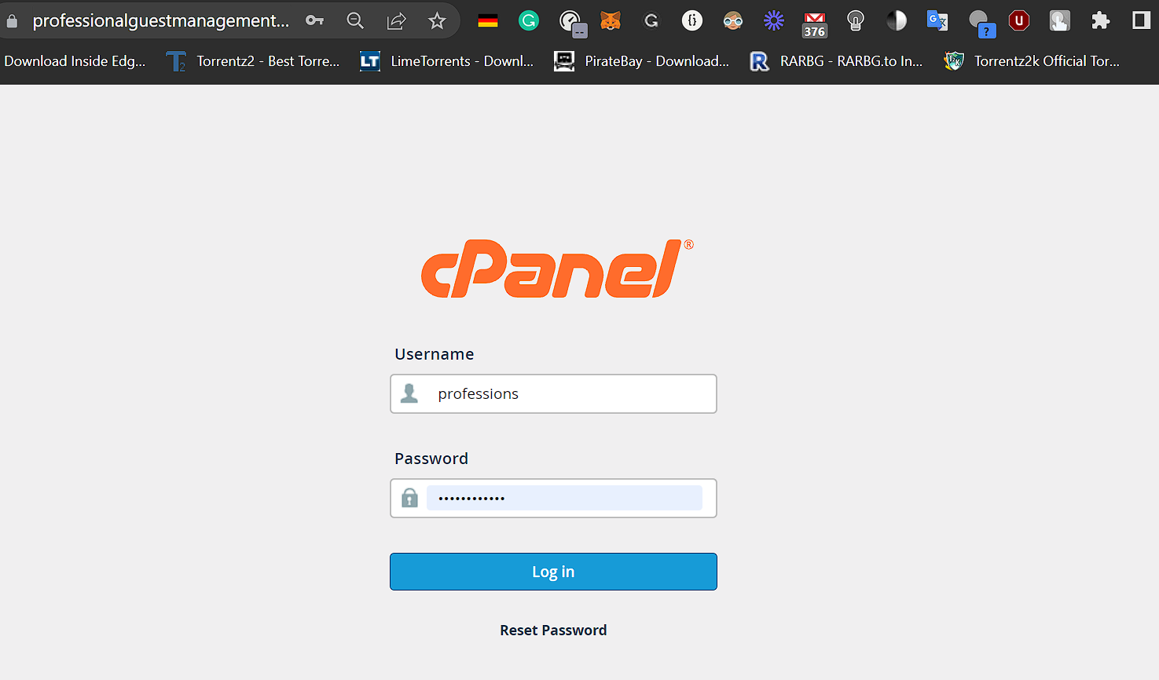
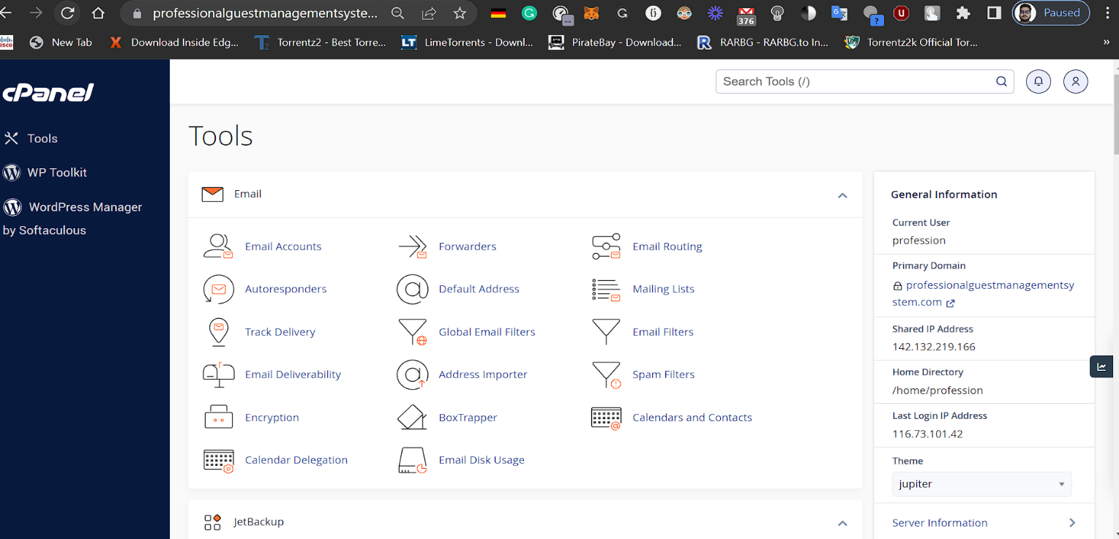
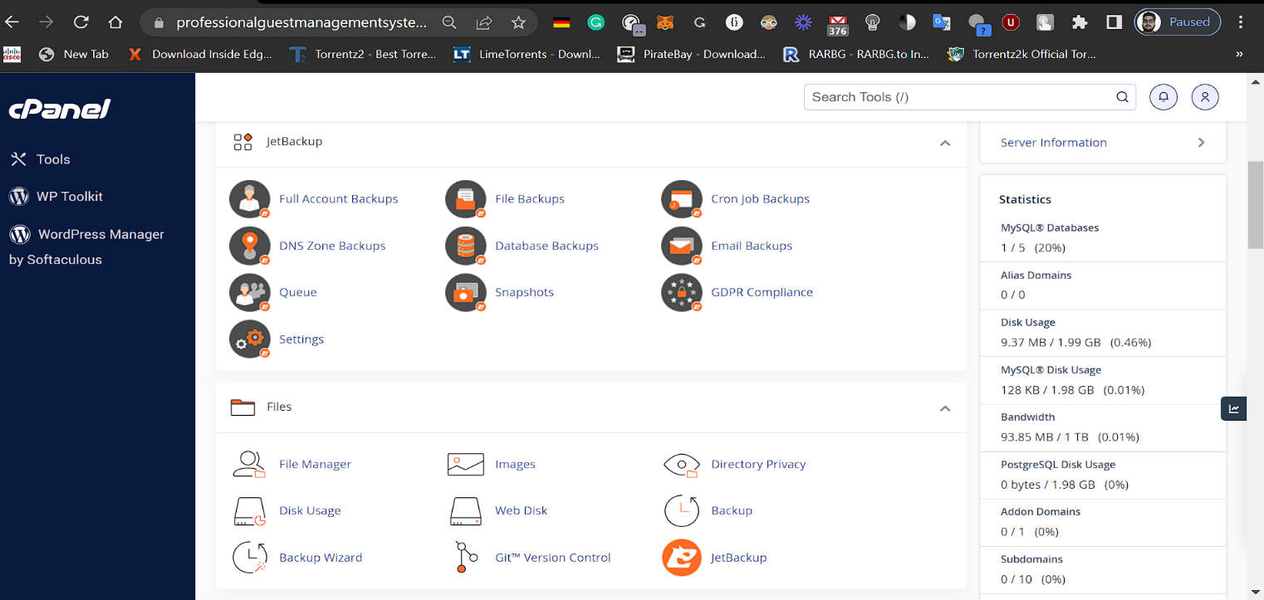
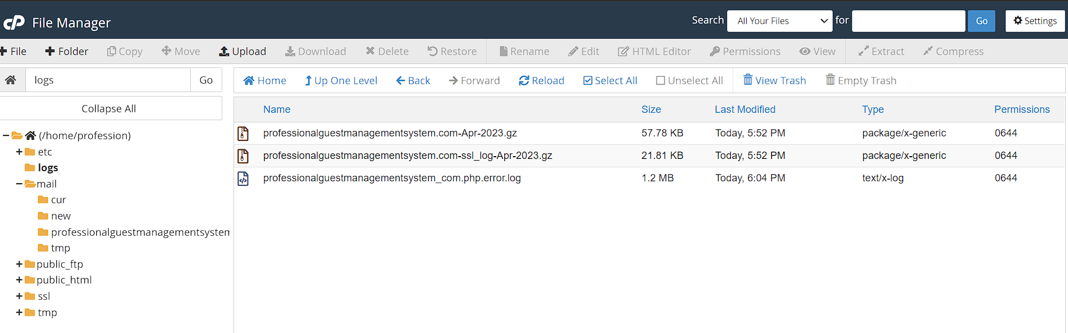
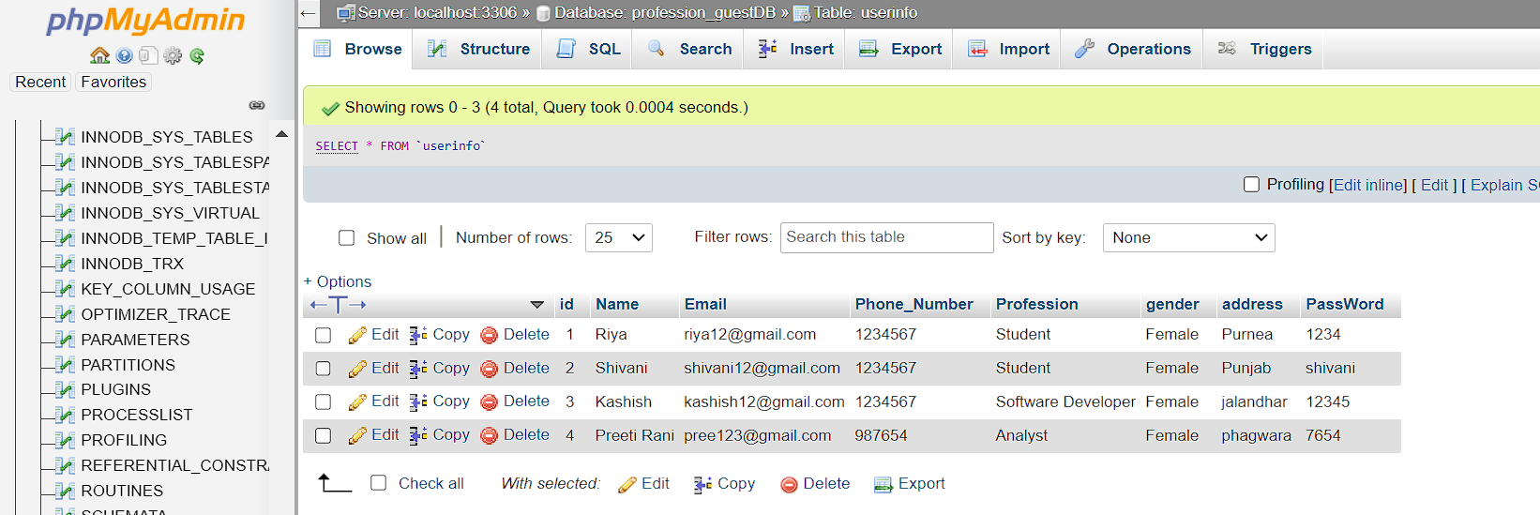

Slide 13
Testing of website(Vulsoln)
Once the development is completed, the system goes through rigorous testing to identify and fix any bugs, errors, or issues. This includes functional testing to ensure that the system meets the requirements, usability testing to evaluate the system's user-friendliness, performance testing to check for system performance under different loads, and security testing to identify and fix any security vulnerabilities.
VulSoln is a command-line tool designed to perform security checks on web servers. It is a bash script that runs on Linux and Unix operating systems and checks for SSL/TLS vulnerabilities and other potential security weaknesses.
• Supports SSL/TLS protocols: VulSoln supports various SSL/TLS protocols such as SSLv2, SSLv3, TLSv1.0, TLSv1.1, and TLSv1.2. This allows security professionals to test the security of their systems against various SSL/TLS vulnerabilities.
• Supports Cipher Suites: VulSoln supports various cipher suites such as RC4, DES, 3DES, AES, and ChaCha20. This helps security professionals to test the security of their systems against various cipher suite vulnerabilities.
• Checks for Vulnerabilities: VulSoln checks for various vulnerabilities such as Owasp top 10, POODLE, Heartbleed, DROWN, and BEAST. This helps security professionals to identify potential vulnerabilities in their systems and take necessary actions to fix them.
• Easy to use: VulSoln is a command-line tool and is easy to use. It requires no installation and can be used directly from the command line.
./vulsoln.sh [options] [:port]

Slide 14
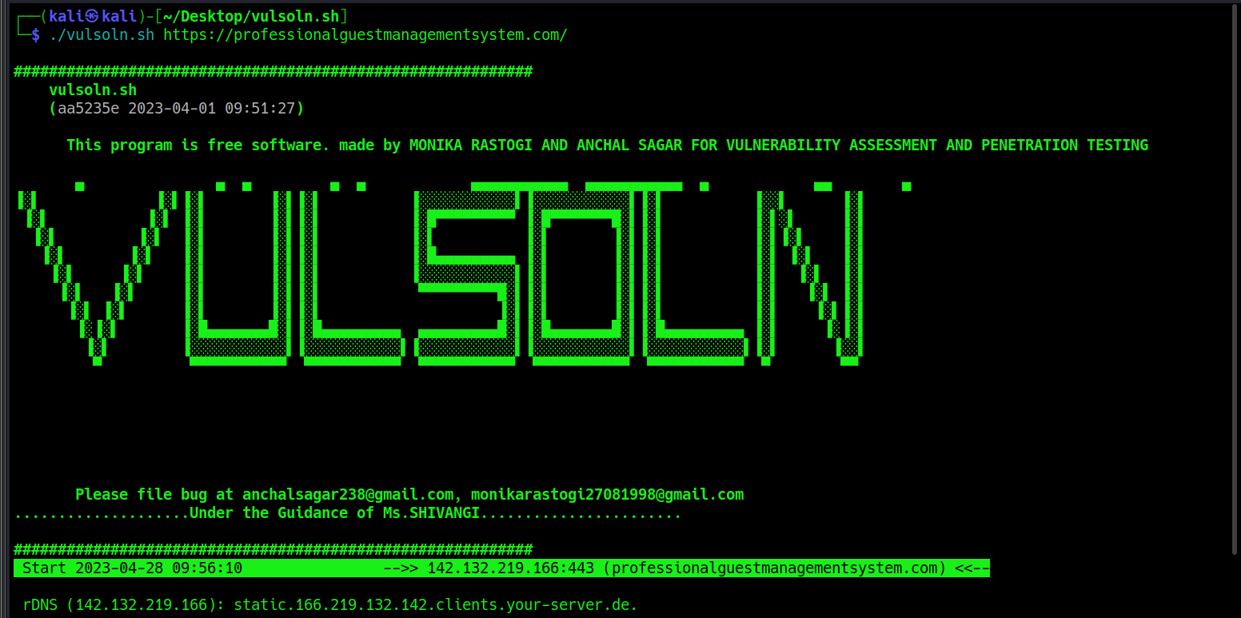
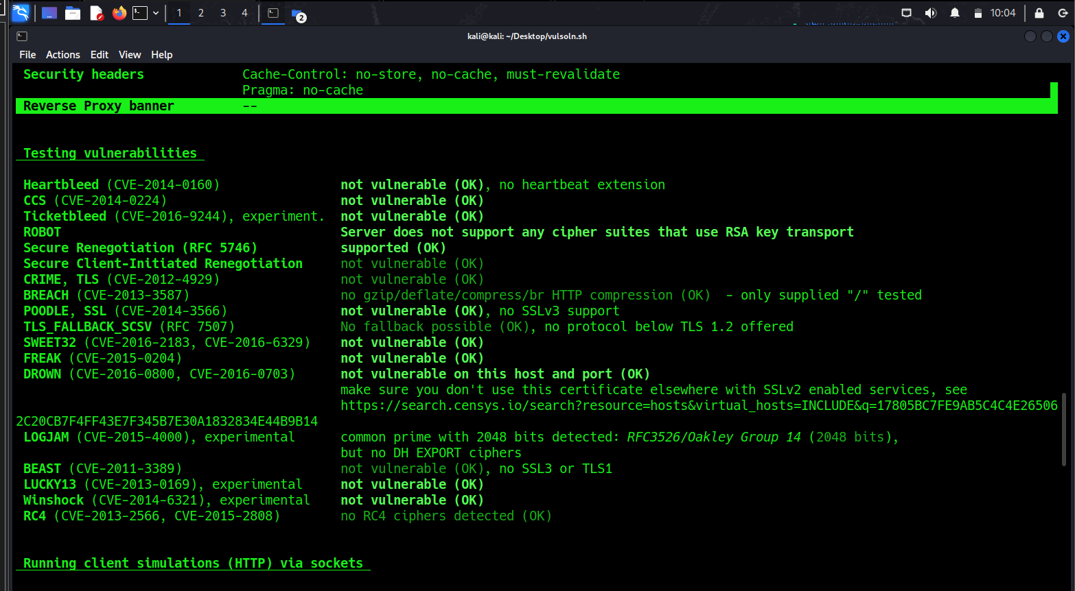
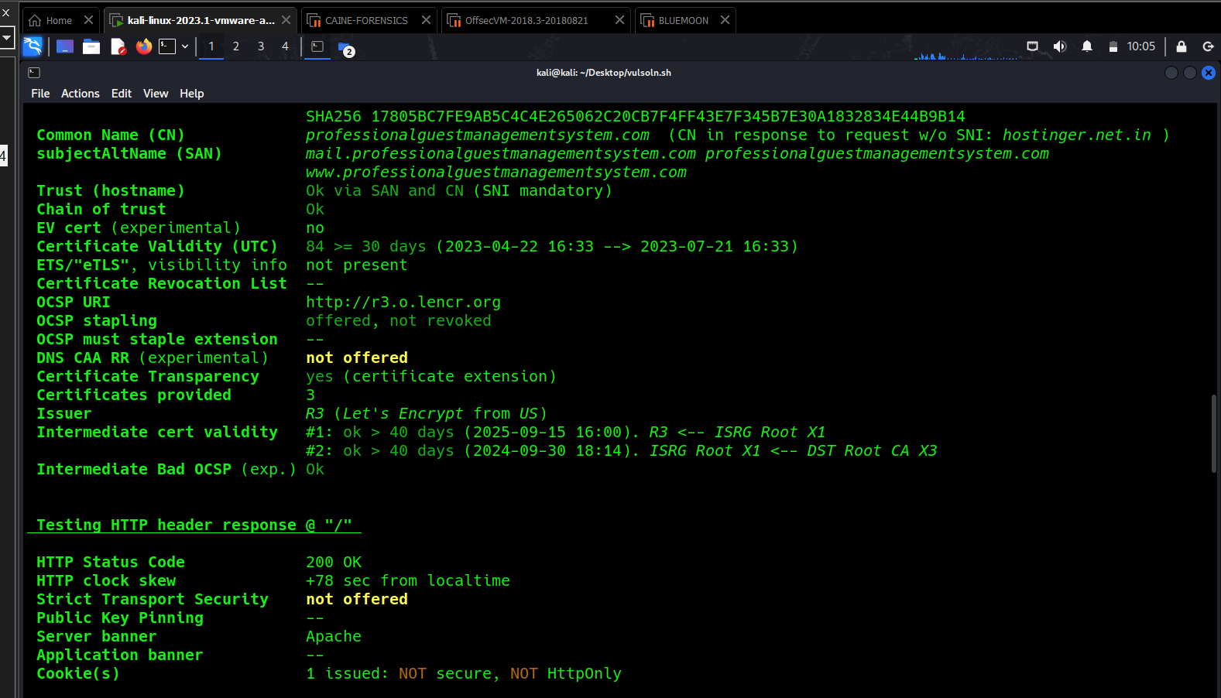
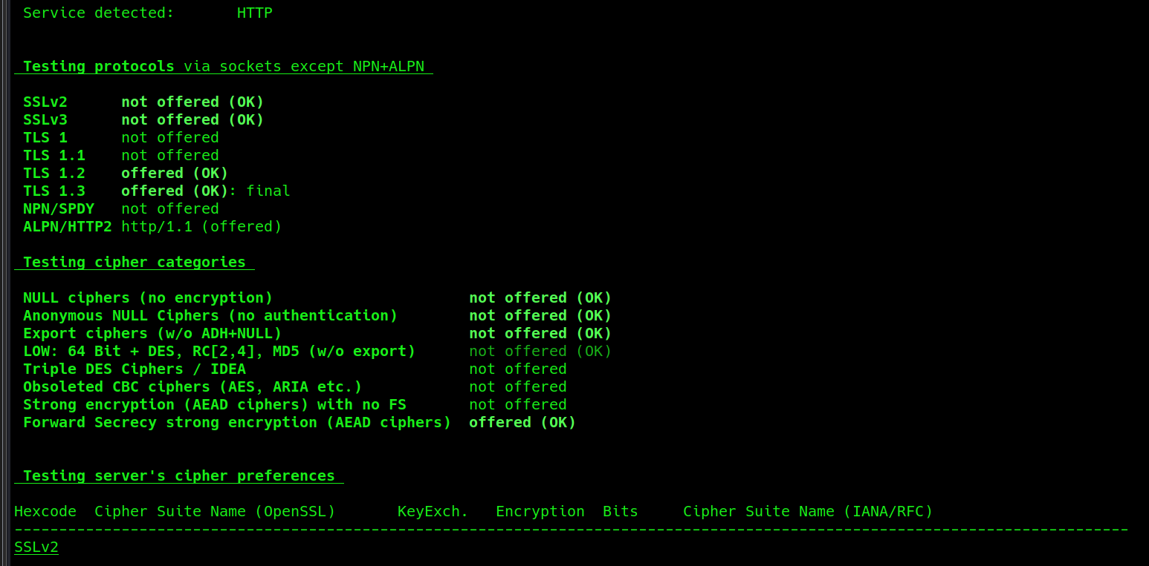

Slide 15
Future Scope
Personalization and AI: Integrating artificial intelligence (AI) technologies into websites can enhance user experiences through personalized recommendations, chatbots, and intelligent search functions. Integrating artificial intelligence (AI) technologies into automated Linux script includes Anomaly Detection, Threat Intelligence, Intelligent incident response, Security testing and vulnerability scanning, and Continuous compliance monitoring.
Mobile optimization: With the increasing use of smartphones and tablets, optimizing websites for mobile devices is crucial to reach a wider audience and provide a seamless browsing experience.
Cloud computing: With the increasing adoption of cloud services, automated Linux scripts can help in managing cloud resources, provisioning and configuring virtual machines, and optimizing cloud infrastructure.
Security and compliance: Automated scripts can assist in performing security audits, vulnerability assessments, and compliance checks on Linux systems, ensuring they adhere to industry standards and best practices
In both cases, staying up-to-date with the latest trends and technologies, such as AI, mobile optimization, cloud computing, and cybersecurity, will be crucial for long-term success. Additionally, considering user needs, market demands, and scalability will help shape the future scope of websites and automated Linux scripts.

Slide 16
Thank you!

